Slide 1

ETMS
Employee Training Management System

Slide 2
Employee Training
Management System
Requires a logon:
https://cardmaillouisville.sharepoint.com/sites/etms
Being that browsers are not standardized at this time, you may need to test which browser works best for you.

Slide 3
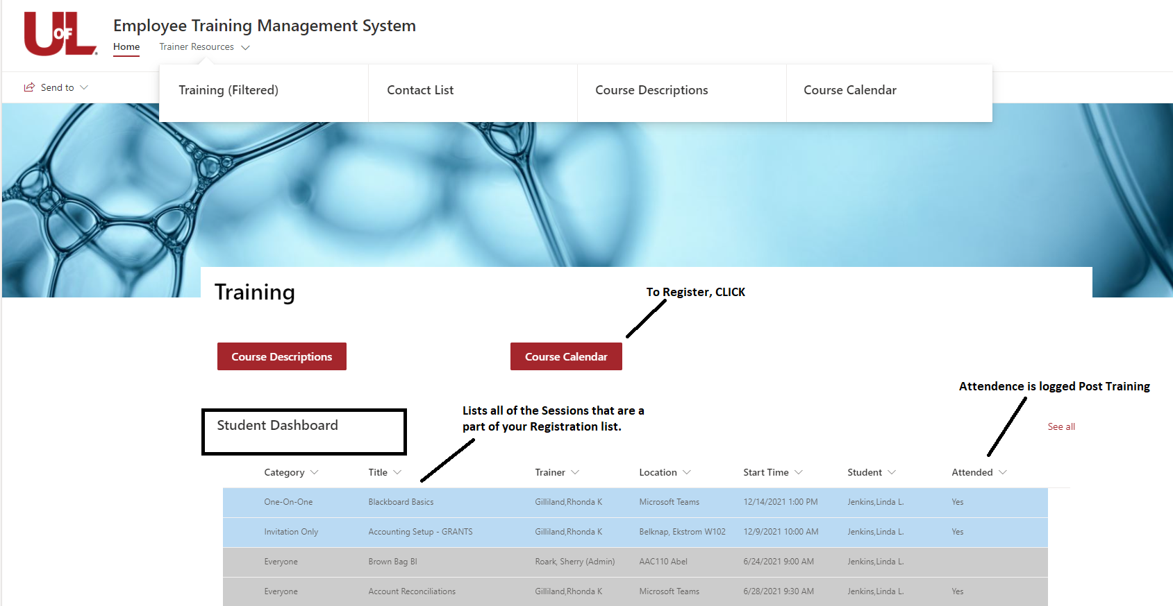
Home Page

Slide 4
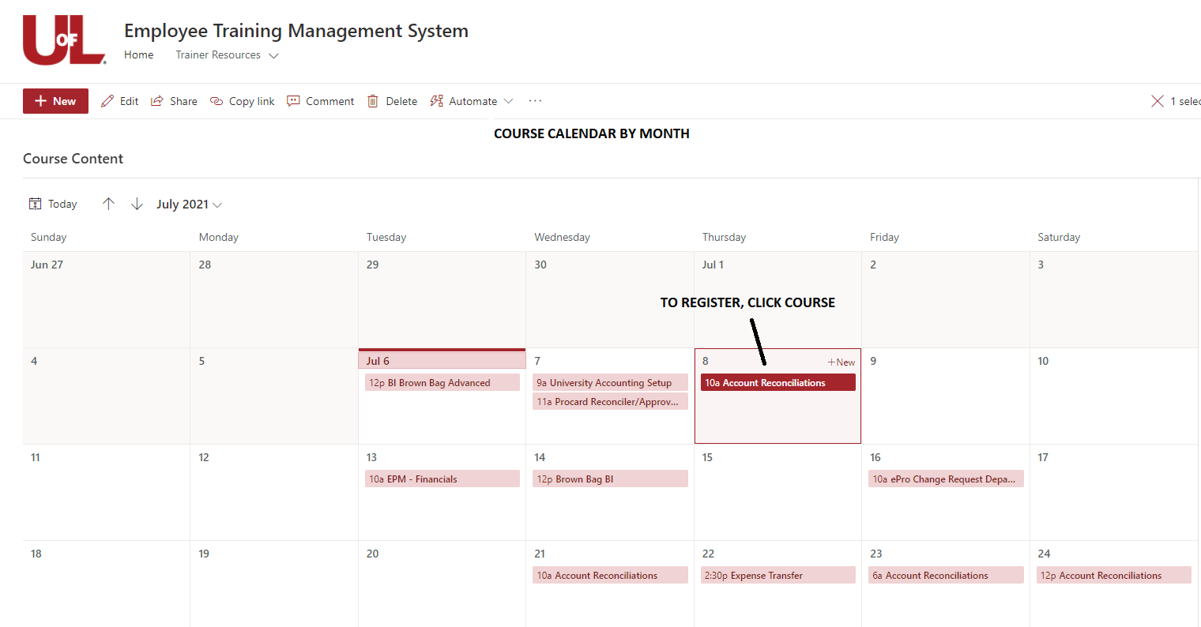
CALENDAR OF
SCHEDULED COURSES

Slide 5
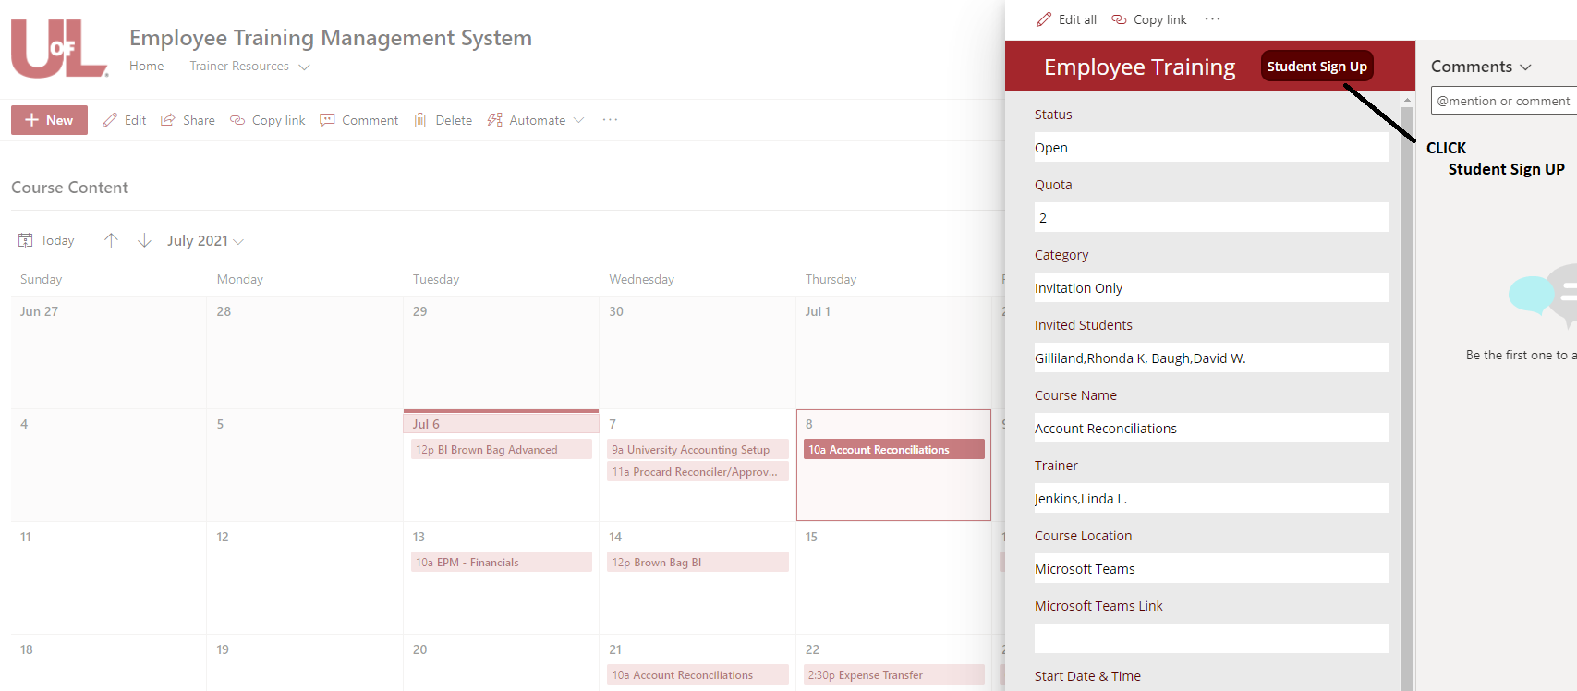
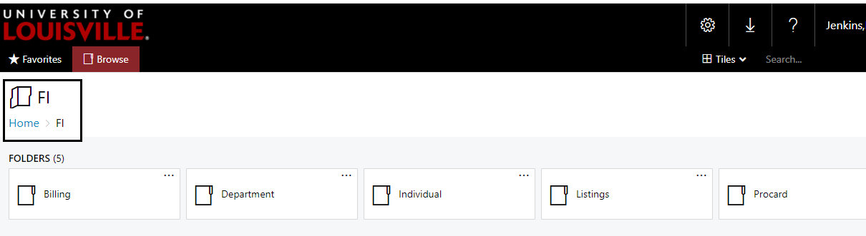
Student Sign Up

Slide 6
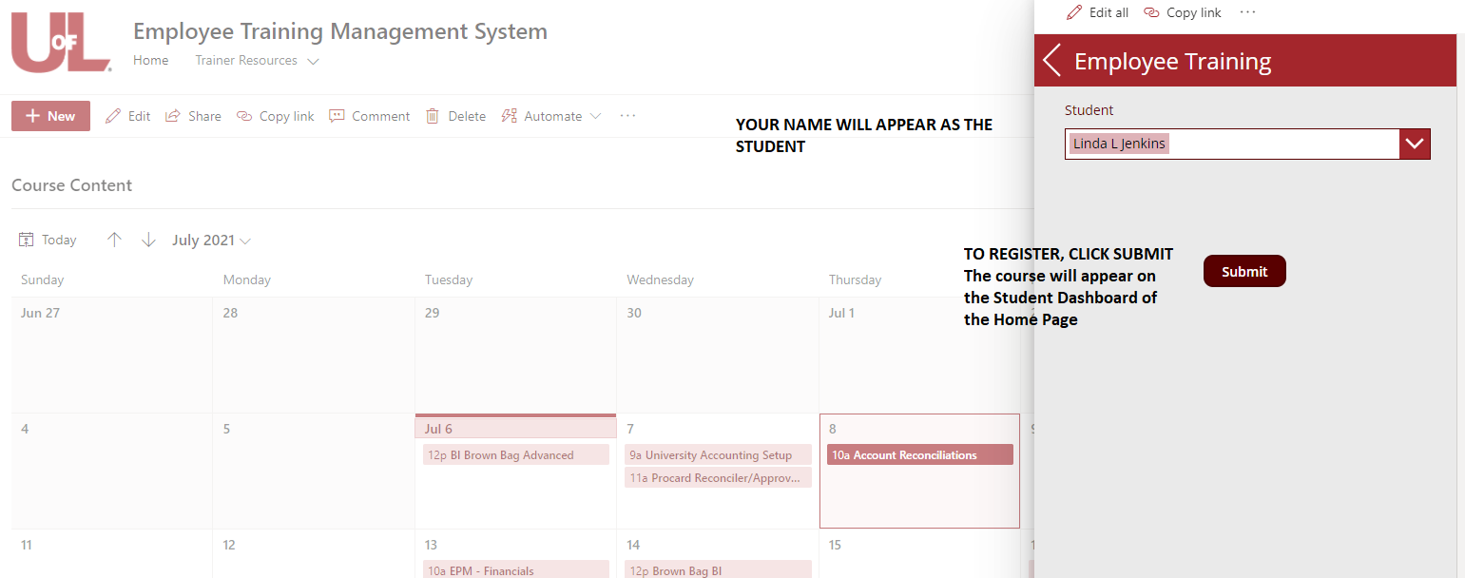
STUDENT REGISTRATION

